Slide 1
FLOODWATCH
Reading Lagos Through Its Floods — A Data Story
Crowdsourced Flood Monitoring & Weather Severity Analytics for Lagos, Nigeria
Prepared by Chimbuchi Okey Ofoedu · Group 6 DA · July 2026

Slide 2
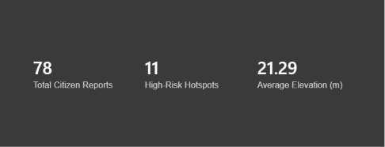
01
The Scale of the Problem
Over just a few weeks, Lagos residents flagged 78 flood incidents across the city. Eleven locations emerged as high-risk hotspots — many sitting at an average elevation of just 21 metres, low enough that a single heavy downpour can overwhelm them.
FloodWatch · Group 6 DA

Slide 3
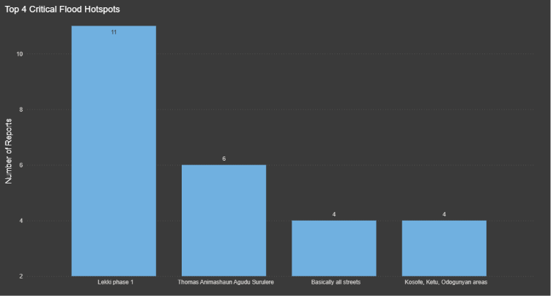
02
Where It Hits Hardest
Lekki Phase 1 stands out as the single most-reported hotspot — more reports than the next three locations combined. This is where flood response, and the app's alerts, need to concentrate first.
FloodWatch · Group 6 DA

Slide 4
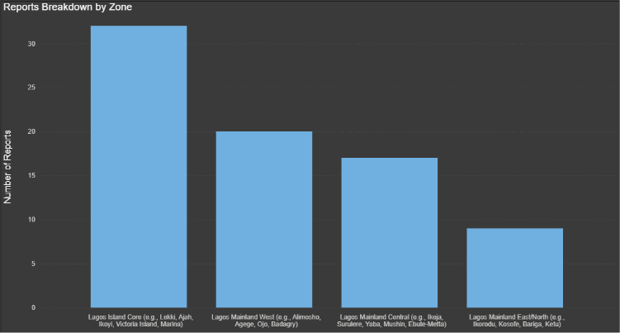
03
A Citywide Pattern
Zoom out from individual streets and the pattern holds citywide: Lagos Island Core absorbs the highest report volume, nearly double the other zones. Flooding isn't scattered randomly — it clusters where drainage and elevation make residents most vulnerable.
FloodWatch · Group 6 DA

Slide 5
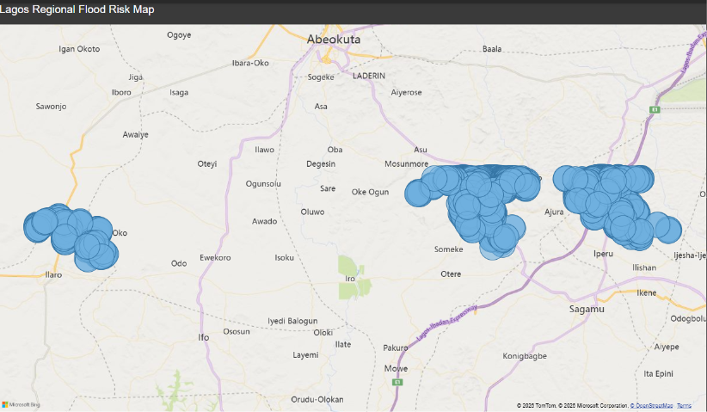
04
Mapping the Risk
Plotting every report on the map turns the pattern into geography: three distinct clusters emerge across Lagos's mainland and island zones — exactly the areas FloodWatch needs to prioritize for real-time monitoring.
FloodWatch · Group 6 DA

Slide 6
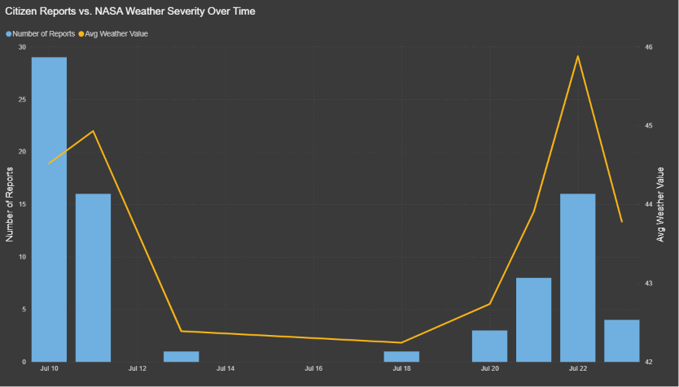
05
Reports Track the Rain
Citizen reports don't happen at random — they spike in near lock-step with NASA's weather severity readings. When the weather metric climbs, flood reports follow, confirming residents are reporting real conditions, not noise.
FloodWatch · Group 6 DA

Slide 7
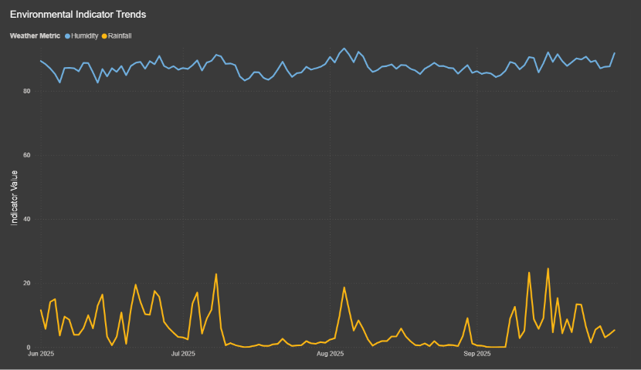
06
Rainfall Drives the Spikes
Humidity stays fairly constant across months, but rainfall is the volatile variable — and its spikes line up with the flood-reporting surges from the previous slide. Rainfall, not humidity, is the metric to design around.
FloodWatch · Group 6 DA

Slide 8
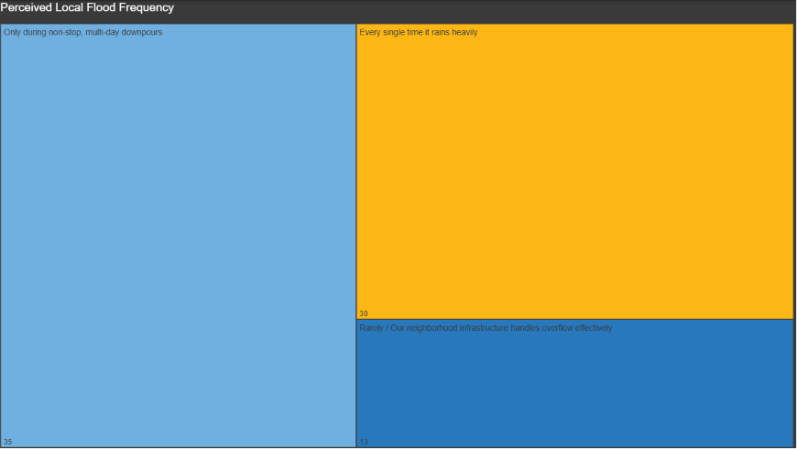
07
How Residents Experience It
Ask residents directly and the picture sharpens: the largest group says flooding happens every single time it rains heavily — not only during rare, extreme storms. This is a frequent, everyday disruption.
FloodWatch · Group 6 DA

Slide 9
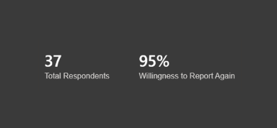
08
Meet Our Community
These insights come from 37 residents surveyed directly — and 95% of them said they'd willingly report a flood again. A strong signal that the community wants to participate, if given the right tool.
FloodWatch · Group 6 DA

Slide 10
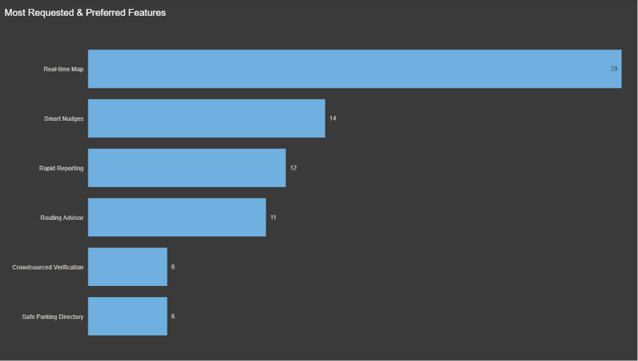
09
What They Want From FloodWatch
When asked directly, a real-time map dominates every other request — more than double the next most-wanted feature, smart nudges. This should anchor the app's core experience.
FloodWatch · Group 6 DA

Slide 11
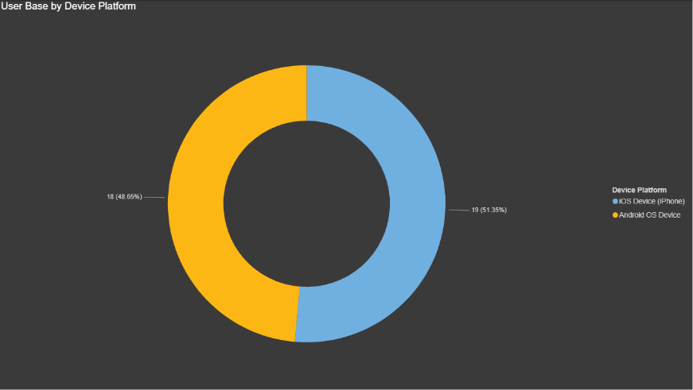
10
Built For Every Phone
The user base splits almost exactly down the middle between iOS and Android — 48.6% to 51.4%. Neither platform can be an afterthought; FloodWatch needs full feature parity on both.
FloodWatch · Group 6 DA

Slide 12
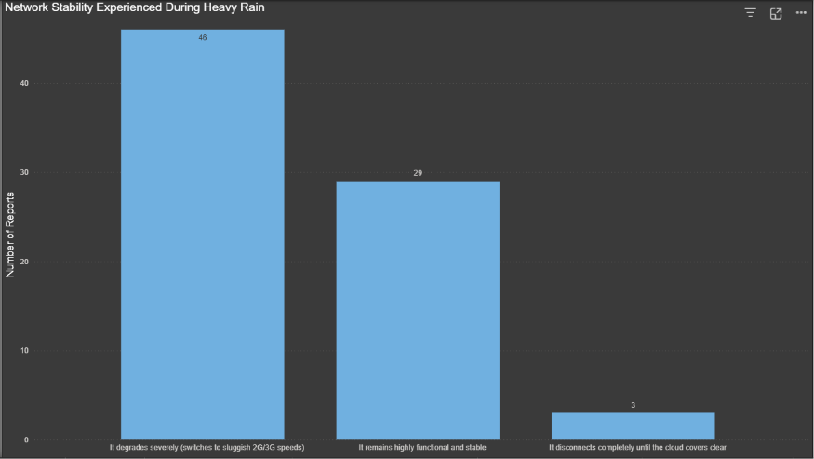
11
The Connectivity Challenge
Here's the catch: during heavy rain, network service degrades severely for most users, and a small share loses connection entirely. Any real-time feature has to keep working even when the network doesn't.
FloodWatch · Group 6 DA

Slide 13
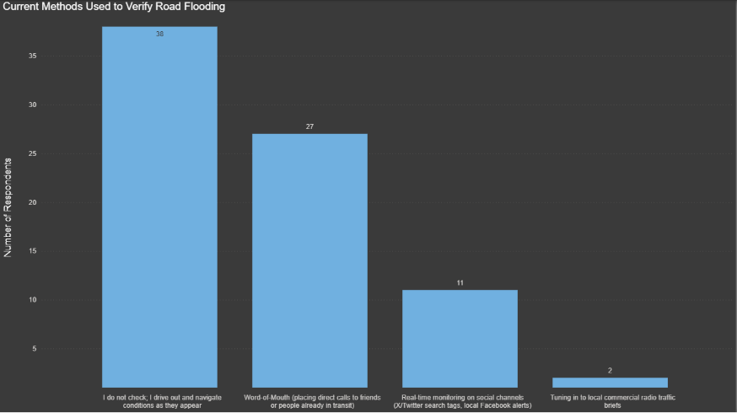
12
Why a Better Way Is Needed
Right now, most residents rely on the least reliable method available — driving out to check conditions themselves — followed by word-of-mouth. Almost no one uses real-time monitoring. This is exactly the gap FloodWatch closes.
FloodWatch · Group 6 DA

Slide 14
From Data to Action
78 reports, 11 hotspots, one clear priority zone: Lekki Phase 1
Rainfall — not humidity — is the leading indicator to design around
Residents want a real-time map that keeps working when the network doesn't
Thank you.
Group 6 DA · FloodWatch · July 2026

Slide 15
The Team - Data Analysts
Chimbuchi Ofoedu
Chinedum Chibueze
Chisom Ibeh
Nnoka Omezikam
Thank you.
Group 6 DA · FloodWatch · July 2026

